Slide 1
Motivation at Work
Session 11

Slide 2
What is Motivation?
Motivation is the willingness to exert high levels of effort to reach organizational goals, conditioned by the effort's ability to satisfy some individual need
The effort element is a measure of intensity or drive. Effort that is directed toward, and consistent with, organizational goals
A need refers to some internal state that makes certain outcomes appear attractive. An unsatisfied need creates tension that stimulates drives within an individual. These drives lead to a search behavior to find particular goals that, if attained, will satisfy the need and reduce the tension

Slide 3
Motivation Process
Unsatisfied Need
Tension
Drives
Search behavior
Satisfied need
Reduction of tension

Slide 4
Early theories of motivation

Slide 5
Maslow’s Hierarchy of Needs theory
Maslow proposed that within every person is a hierarchy of five needs:
Physiological needs: food, drink, shelter, sexual satisfaction, and other physical requirements.
Safety needs: security and protection from physical and emotional harm, as well as assurance that physical needs will continue to be met.
Social needs: affection, belongingness, acceptance, and friendship.
Esteem needs: internal esteem factors such as self-respect, autonomy, and achievement and external esteem factors such as status, recognition, and attention.
Self-actualization needs: growth, achieving one's potential, and self-fulfillment; the drive to become what one is capable of becoming.

Slide 6
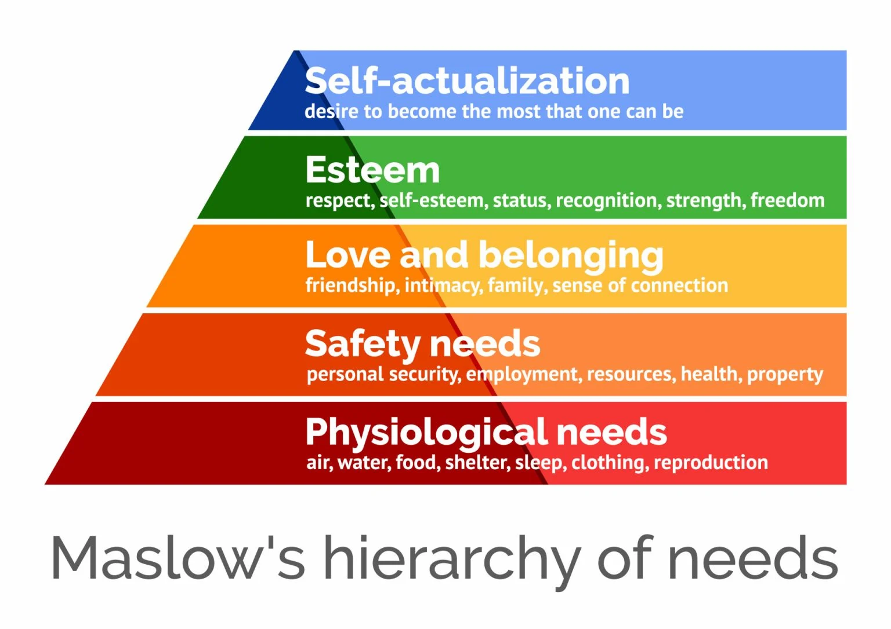

Slide 7
Maslow argued that each level in the hierarchy must be substantially satisfied before the next is activated and that once a need is substantially satisfied it no longer motivates behavior. Therefore, as each need is substantially satisfied, the next need becomes dominant
Maslow's theory proposed that, although no need is ever fully satisfied, a substantially satisfied need will no longer motivate an individual
Maslow separated the five needs into higher and lower levels. Physiological and safety needs were described as lower-order needs; social, esteem, and self-actualization were described as higher-order needs.
Higher-order needs are satisfied internally while lower-order needs are predominantly satisfied externally.

Slide 8
McGregor's Theory X and Theory Y
Theory X presents an essentially negative view of people. It assumes that workers have little ambition, dislike work, want to avoid responsibility, and need to be closely controlled to work effectively.
Theory Y offers a positive view. It assumes that workers can exercise self-direction, accept and actually seek out responsibility, and consider work to be a natural activity.
McGregor believed that Theory Y assumptions better captured the true nature of workers and should guide management practice.

Slide 9
Theory X assumed that lower-order needs dominated individuals, and Theory Y assumed that higher-order needs dominated.
McGregor himself held to the belief that the assumptions of Theory Y were more valid than those of Theory X. Therefore, he proposed that participation in decision making, responsible and challenging jobs, and good group relations would maximize employee motivation

Slide 10
Herzberg's Motivation-Hygiene Theory
Frederick Herzberg's motivation-hygiene theory proposes that intrinsic factors are related to job satisfaction and motivation, whereas extrinsic factors are associated with job dissatisfaction
Herzberg investigated the question "What do people want from their jobs?"

Slide 11
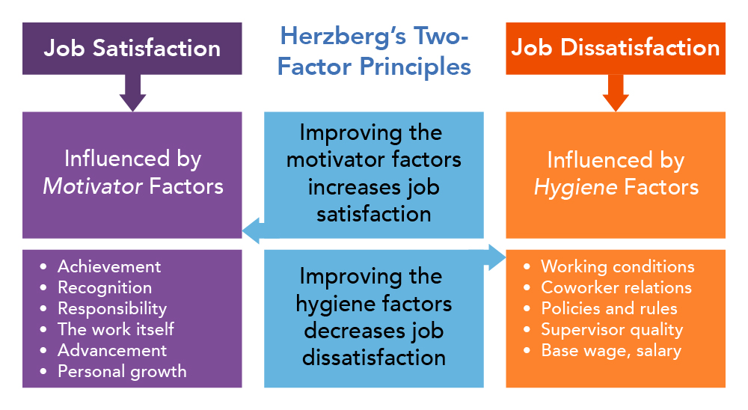

Slide 12
According to Herzberg, the factors that led to job satisfaction were separate and distinct from those that led to job dissatisfaction.
Therefore, managers who sought to eliminate factors that created job dissatisfaction could bring about workplace harmony but not necessarily motivation.
Because they don't motivate employees, the extrinsic factors that create job dissatisfaction were called hygiene factors. When these factors are adequate, people will not be dissatisfied, but they will not be satisfied (or motivated) either.
To motivate people on their jobs, Herzberg suggested emphasizing motivators, the intrinsic factors that increase job satisfaction

Slide 13
Contemporary Theories of Motivation

Slide 14
Three-Needs Theory
David McClelland proposed the three-needs theory, which says there are three needs that are major motives in work. These three needs include:
the need for achievement (nAch): which is the drive to excel, to achieve in relation to a set of standards, and to strive to succeed;
the need for power (nPow): which is the need to make others behave in a way that they would not have behaved otherwise; and
the need for affiliation (nAff): which is the desire for friendly and close interpersonal relationships.

Slide 15
People with a high need for achievement are striving for personal achievement
The needs for affiliation and power are closely related to managerial success.
The best managers tend to be high in the need for power and low in the need for affiliation.

Slide 16
Goal-Setting Theory
Specific goals increase performance and that difficult goals, when accepted, result in higher performance than do easy goals
Intention to work toward a goal is a major source of job motivation
Specific, hard goals produce a higher level of output than does the generalized goal of "do your best." The specificity of the goal itself acts as an internal stimulus.

Slide 17
Factors influencing goals-performance relationship
People will do better when they get feedback on how well they're progressing toward their goals because feedback helps identify discrepancies between what they have done and what they want to do; that is, feedback acts to guide behavior
Goal commitment: an individual is committed to the goal—that is, an individual is determined not to lower or abandon the goal
Self-efficacy: an individual's belief that he or she is capable of performing a task. The higher your self-efficacy, the more confidence you have in your ability to succeed in a task
National culture: subordinates will be reasonably independent , that managers and employees will seek challenging goals, and that performance is considered important by both managers and subordinates

Slide 18
Reinforcement Theory
Behavior is a function of its consequences.
Reinforcement theory argues that behavior is externally caused.
What controls behavior are reinforcers, consequences that, when given immediately following a behavior, increase the probability that the behavior will be repeated.
According to B. F. Skinner, reinforcement theory can be explained as follows: People will most likely engage in desired behaviors if they are rewarded for doing so; these rewards are most effective if they immediately follow a desired behavior, and behavior that isn't rewarded, or is punished, is less likely to be repeated

Slide 19
Designing Motivating Jobs
Job design: the way tasks are combined to form complete jobs
Job enlargement: the horizontal expansion of a job through increasing job scope—the number of different tasks required in a job and the frequency with which these tasks are repeated.
Job enrichment: increases job depth, which is the degree of control employees have over their work. In other words, employees are empowered to assume some of the tasks typically done by their managers

Slide 20
Job characteristics model (JCM)
According to the JCM, any job can be described in terms of five core dimensions, defined as follows:
Skill variety, the degree to which a job requires a variety of activities so that an employee can use a number of different skills and talents
Task identity, the degree to which a job requires completion of a whole and identifiable piece of work
Task significance, the degree to which a job has a substantial impact on the lives or work of other people
Autonomy, the degree to which a job provides substantial freedom, independence, and discretion to the individual in scheduling the work and determining the procedures to be used in carrying it out
Feedback, the degree to which carrying out work activities required by a job results in the individual's obtaining direct and clear information about the effectiveness of his or her performance

Slide 21
From a motivational standpoint, the JCM suggests that internal rewards are obtained when an employee learns (knowledge of results through feedback) that he or she personally (experienced responsibility through autonomy of work) has performed well on a task that he or she cares about (experienced meaningfulness through skill variety, task identity, and/or task significance).

Slide 22
Methods of Job redesign according to JCM
Combine tasks. Managers should put existing fragmented tasks back together to form a new, larger module of work (job enlargement) to increase skill variety and task identity.
Create natural work units. Managers should design tasks that form an identifiable and meaningful whole to increase employee "ownership" of the work and encourage employees to view their work as meaningful and important rather than as irrelevant and boring.
Establish client relationships. The client is the external or internal user of the product or service on which the employee works. Whenever possible, managers should establish direct relationships between workers and their clients to increase skill variety, autonomy, and feedback.
Expand jobs vertically. Vertical expansion (job enrichment) gives employees responsibilities and controls that were formerly reserved for managers. It partially closes the gap between the "doing" and the "controlling" aspects of the job and increases employee autonomy.
5. Open feedback channels. Feedback lets employees know not only how well they are performing their jobs but also whether their job performance is improving, deteriorating, or remaining constant. Ideally, employees should receive performance feedback directly as they do their jobs rather than from managers on an occasional basis.

Slide 23
Equity Theory
The term equity is related to the concept of fairness and equal treatment compared with others who behave in similar ways
Equity theory, developed by J. Stacey Adams, proposes that employees perceive what they get from a job situation (outcomes) in relation to what they put into it (inputs) and then compare their inputs-outcomes ratio with the inputs-outcomes ratios of relevant others
If an employee perceives her ratio to be equal to those of relevant others, a state of equity exists. In other words, she perceives that her situation is fair—that justice prevails. However, if the ratio is unequal, inequity exists and she views herself as underrewarded or overrewarded.

Slide 24
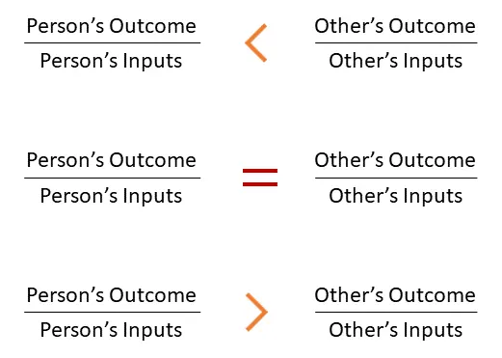
It is considered to be an equity when:

Slide 25
Equity theory proposes that employees might (1) distort either their own or others' inputs or outcomes, (2) behave in some way to induce others to change their inputs or outcomes, (3) behave in some way to change their own inputs or outcomes, (4) choose a different comparison person, or (5) quit their job. These types of employee reactions have generally proved to be correct
Employee motivation is influenced significantly by relative rewards as well as by absolute rewards. Whenever employees perceive inequity, they'll act to correct the situation. The result might be lower or higher productivity, improved or reduced quality of output, increased absenteeism, or voluntary resignation.

Slide 26
The other aspect we need to examine in equity theory is who these "others" are against whom people compare themselves.
The referent is an important variable in equity theory.
Three referent categories have been defined: other, system, and self.
The "other" category includes other individuals with similar jobs in the same organization but also includes friends, neighbors, or professional associates.
The "system" category includes organizational pay policies and procedures and the administration of the system. Whatever precedents have been established by the organization regarding pay allocation are major elements of this category.
The "self" category refers to inputs-outcomes ratios that are unique to the individual. It reflects past personal experiences and contacts and is influenced by criteria such as past jobs or family commitments.

Slide 27
Expectancy Theory (Victor Vroom)
Expectancy theory states that an individual tends to act in a certain way based on the expectation that the act will be followed by a given outcome and on the attractiveness of that outcome to the individual.
It includes three variables or relationships:
Expectancy or effort-performance linkage is the probability perceived by the individual that exerting a given amount of effort will lead to a certain level of performance.
Instrumentality or performance-reward linkage is the degree to which the individual believes that performing at a particular level is instrumental in attaining the desired outcome.
Valence or attractiveness of reward is the importance that the individual places on the potential outcome or reward that can be achieved on the job. Valence considers both the goals and needs of the individual.

Slide 28
Key questions regarding Expectancy Theory
First, what perceived outcomes does the job offer the employee? Outcomes (rewards) may be positive—things such as pay, security, companionship, trust, fringe benefits, a chance to use talents or skills, or congenial relationships. Or the employee may view the outcomes as negative—fatigue, boredom, frustration, anxiety, harsh supervision, or threat of dismissal.

Slide 29
Second, how attractive are the outcomes or rewards to employees? Are they valued positively, negatively, or neutrally? This obviously is a personal and internal issue that depends on the individual's needs, attitudes, and personality. A person who finds a particular reward attractive—that is, values it positively—would rather get it than not get it. Others may find it negative and, therefore, prefer not getting it. Still others may be neutral about the outcome.

Slide 30
Third, what kind of behavior must the employee exhibit in order to achieve these rewards? The rewards aren't likely to have any effect on an individual employee's performance unless he or she knows, clearly and unambiguously, what must be done to achieve them.
Finally, how does the employee view his or her chances of doing what is asked? After an employee has considered his or her own skills and ability to control those variables that lead to success, what's the likelihood that he or she can successfully perform at the necessary level?

Slide 31
Current Issues in Motivation
Motivating a diverse workforce: Flexible Working Schedules
A compressed workweek is a workweek in which employees work longer hours per day but fewer days per week.
Flexible work hours (also popularly known as flextime), which is a scheduling system in which employees are required to work a specific number of hours a week but are free to vary those hours within certain limits
Job sharing: the practice of having two or more people split a full-time job
Telecommuting: employees work at home and are linked to the workplace by computer and modem.

Slide 32
Pay-for-performance programs are compensation plans that pay employees on the basis of some performance measure
Cultural differences in motivation
Open book management: Many organizations of various sizes are involving their employees in workplace decisions by opening up the financial statements (the "books"). They share that information so that employees will be motivated to make better decisions about their work and better able to understand the implications of what they do, how they do it, and the ultimate impact on the bottom line. This approach is called open-book management. The goal of open-book management is to get employees to think like an owner by seeing the impact their decisions and actions have on financial results.

Slide 33
Motivating the “new workforce”
Motivating Professionals
Motivating Contingent Workers
Motivating Low-Skilled, Minimum-Wage Employees

Slide 34
Suggestions for motivating employees
Recognize individual differences. Employees aren't identical. They have different needs, attitudes, personality, and other important individual variables.
Match people to jobs.
Use goals. Employees have hard, specific goals and feedback on how well they're doing in achieving those goals.
Ensure that goals are perceived as attainable.
Individualize rewards.
Link rewards to performance.
Check the system for equity.
Don't ignore money.

